Slide 1
Hotel Booking Demand
By: Ankush Jain, Javier Lasa and Supachok Srisukajorn

Slide 2


Questions Addressed
1.
2.
3.
Number of Special Requests
Best Time to Book a Hotel or Resort
Optimal Length of Stay for Best Daily Effective Rate
Ranges between 0 and 5 per booking and affects customer satisfaction
Will help control expenditure by planning resources more effectively
To draw in the more economical vacationers looking for best-value

Slide 3
Analytical Techniques Explored
Lorem 2
Lorem 2
Lorem 2
Clustering
Lorem 3
Lorem 3
Lorem 3
Lorem 1
Predicting
Lorem 1
Lorem 1
Cleansing
Missing Values
Outliers
Variable Reduction
foRmaTTing VaRiables = Clean Data

Slide 4
Analytical Techniques Explored
Lorem 2
Lorem 2
Clustering
Lorem 3
Cleansing
Predicting
Variable Reduction
Trimmed data further, to decrease the total within cluster sum of squares
03
K-means Clustering
Applying a data driven approach to the cleaned dataset containing only numerical variables
01
02
Principal Component Analysis
To increase interpretability and reduce loss of data

Slide 5
Analytical Techniques Explored
Lorem 2
Lorem 2
Lorem 2
Clustering
Lorem 3
Lorem 3
Lorem 3
Lorem 1
Predicting
Lorem 1
Lorem 1
Cleansing
Tree Model
Lower SSE
Linear Regression
Higher SSE

Slide 6
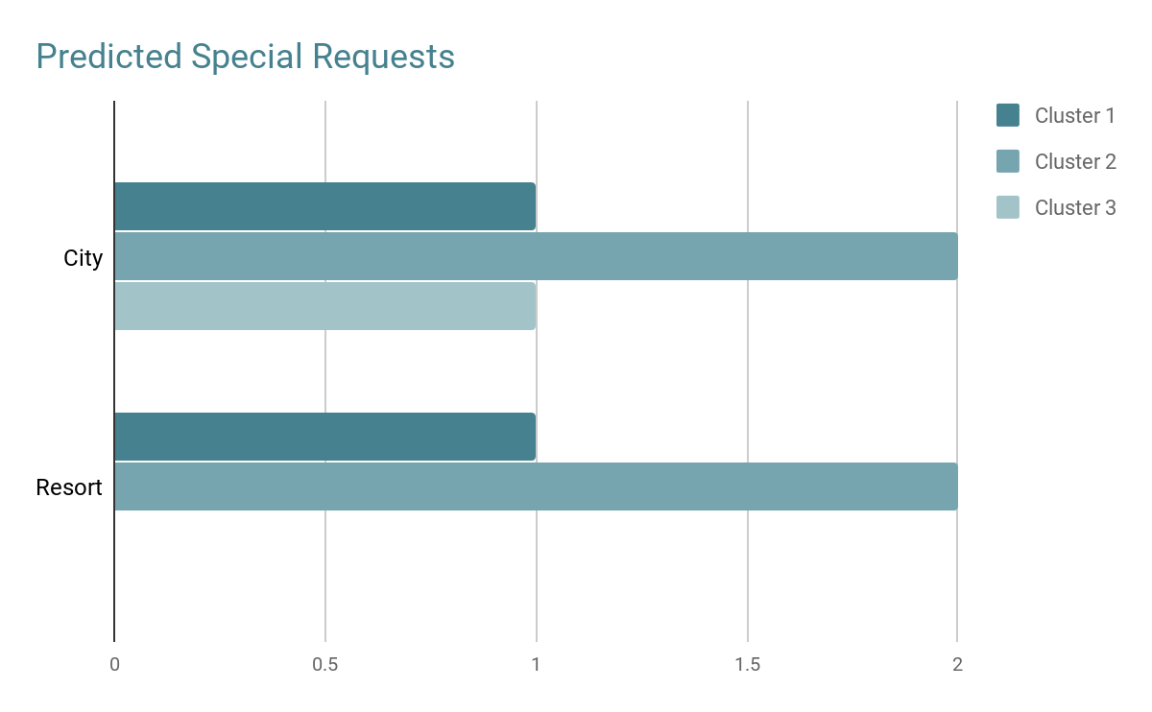
Results
1.
Number of Special Requests
Market Segment | Resort | City | Cluster | City | Resort | Month
 | Offline TA/TO | Direct | 1 | August | July
 | Offline TA/TO | Complementary | 2 | August | May
 | - | Online TA | 3 | July | -

Slide 7
Results
2.
Months | Resort | City | Cluster
 | January | - | 1
 | March | June | 2
 | - | January | 3
Best Time to Book a Hotel or Resort

Slide 8
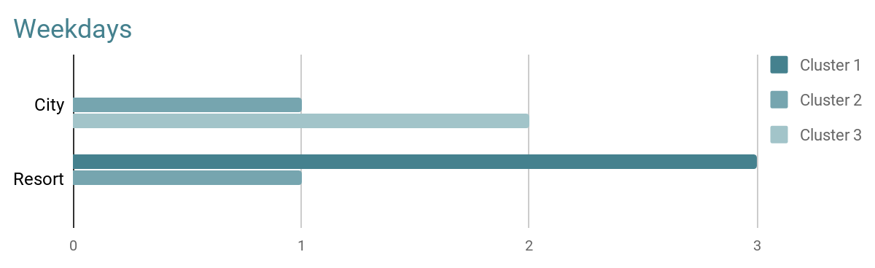
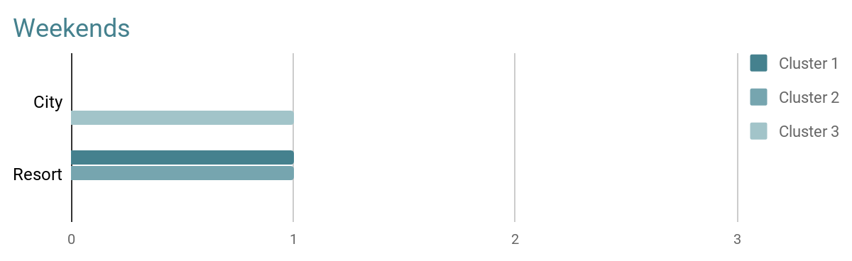
Results
3.
Optimal Length of Stay for Best Daily Effective Rate

Slide 9
Conclusions
Highest number of special requests in May-August (summer)
Control expenses in winter, unless there are special events in the area
Advertise better nightly rates to the budget friendly
Expect more special requests in summer,
lower expenses in winters and
budget friendly vacationers utilizing nightly rates.

